Slide 1
Introduction to Information Retrieval
Dictionaries and Tolerant retrieval

Slide 2
Recap of the previous lecture
Previous chapters: develop the ideas underlying inverted indexes for handling Boolean and proximity queries.
This chapter: develops techniques that are robust to typographical errors in the query, as well as alternative spellings.

Slide 3
This lecture
Data structures that help the search for terms in the vocabulary in an inverted index
“Tolerant” retrieval
A wild-card query
A query such as “*a*e*i*o*u*”
Seeks documents containing any term that includes all the 5 vowels in sequence.
Another example: automat*
Other forms of imprecisely posed queries
Spelling errors and correction
A method for seeking vocabulary terms that are phonetically close to the query term(s)
where the user may not know how a proper name is spelled in documents.

Slide 4
Search structures for dictionaries
Given an inverted index and a query
Our first task: determine whether each query term exists in the vocabulary and, if so, identify the pointer to the corresponding postings.
This vocabulary lookup operation uses a classical data structure called the dictionary.

Slide 5
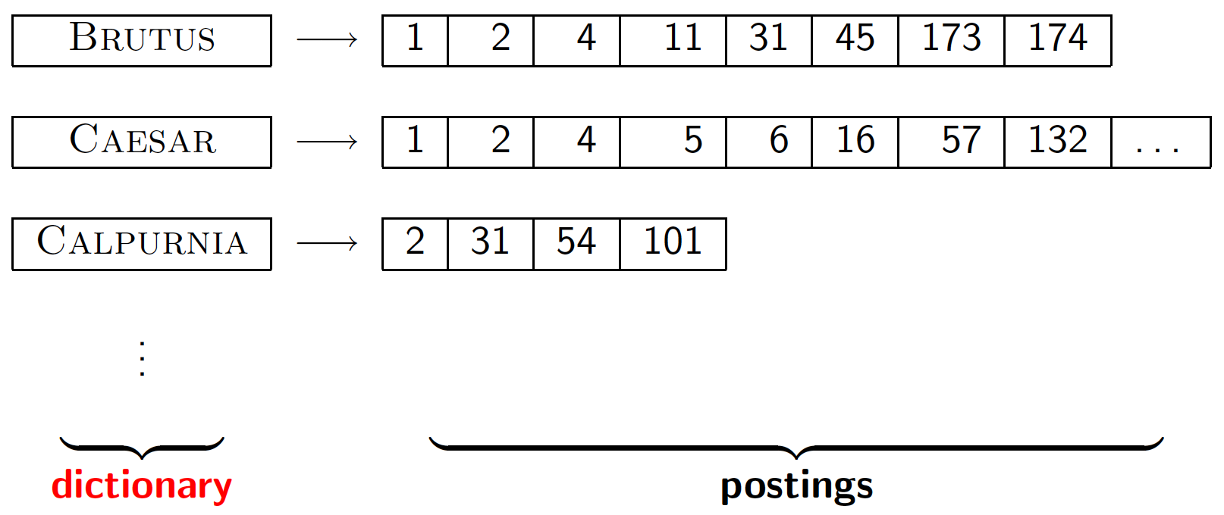
Dictionary data structures for inverted indexes
The dictionary data structure stores the term vocabulary, document frequency, pointers to each postings list … in what data structure?
The above figure is from “ Introduction to Information Retrieval”(C. Manning, P. Raghavan and H. Schütze,, 2008, pg.6).

Slide 6
Dictionary data structures
Two main choices:
Hash table
Search Trees
Some IR systems use hashes, some trees

Slide 7
Hashes (1 of 3)
A hash is an unordered collection of key-value pairs, where each key is unique.
Each vocabulary term (often referred to as a key) is hashed into an integer over a large enough space that hash collisions are unlikely.
At query time, hash each query term separately and follow a pointer to the corresponding postings.

Slide 8
Hashes (2 of 3)
Hashes offer a combination of efficient lookup, insert and delete operations.
Neither arrays nor linked lists can achieve this
A lookup in an unsorted array takes linear worst-case time
In a sorted array, a lookup using binary search is very fast, but insertions become inefficient
In a linked list an insertion can be efficient, but lookups take linear time.

Slide 9
Hashes (3 of 3)
Pros:
Lookup is faster than for a tree: O(1)
Cons:
No easy way to find minor variants of a query term
No prefix search [tolerant retrieval]
E.g., cannot seek (for instance) all terms beginning with the prefix automat.
If the size of the vocabulary keeps growing (in a setting such as the Web), a hash function designed for current needs may not suffice in a few years’ time.

Slide 10
Search Trees
Search Trees overcome many of these issues
E.g., they permit us to enumerate all vocabulary terms beginning with a prefix.
The best-known search tree: binary tree
The search for a term begins at the root of the tree.
Each internal node (including the root) represents a binary test, based on whose outcome the search proceeds to one of the two sub-trees below that node.

Slide 11
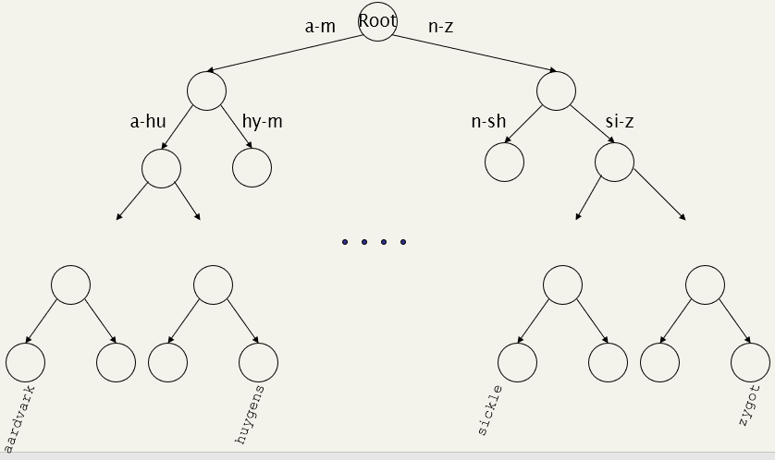
Tree: binary tree
The above figure of a binary search tree is from “ Introduction to Information Retrieval”(C. Manning, P. Raghavan and H. Schütze,, 2008, pg.47.).
A binary search tree. The branch at the root partitions vocabulary terms into two subtrees, those whose first letter is between a and m, and the rest.

Slide 12
Tree: binary tree, cont.
Efficient search hinges on the tree being balanced
The numbers of terms under the two sub-trees of any node are either equal or differ by 1.
The principal issue: rebalancing
As terms are inserted into or deleted from the binary search tree, it needs to be rebalanced so that the balance property is maintained.

Slide 13
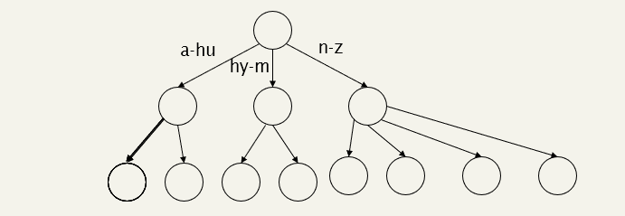
Tree: B-tree
The above figure of a B-tree example is from “ Introduction to Information Retrieval”(C. Manning, P. Raghavan and H. Schütze,, 2008, pg.47.).
To mitigate rebalancing
One approach: allow the number of subtrees under an internal node to vary in a fixed interval.
Definition: Every internal node has a number of children in the interval [a,b] where a, b are appropriate positive integers, e.g., [3,4].

Slide 14
Trees
Simplest: binary tree
More usual: B-trees, Tries
Search trees demand that the characters used in the document collection have a prescribed ordering
E.g., the 26 letters of the English alphabet are always listed in the specific order A through Z.
Pros:
Solves the prefix problem (terms starting with automat)
Cons:
Slower: O(log M) [and this requires balanced tree]
Rebalancing binary trees is expensive
But B-trees mitigate the rebalancing problem

Slide 15
Tries
A trie (from retrieval), is a multi-way tree structure useful for storing strings over an alphabet.
It has been used to store large dictionaries of English words in spelling-checking programs and in natural-language "understanding" programs.
Given the data:
an, ant, all, allot, alloy, aloe, are, ate, be
the corresponding trie would be:

Slide 16
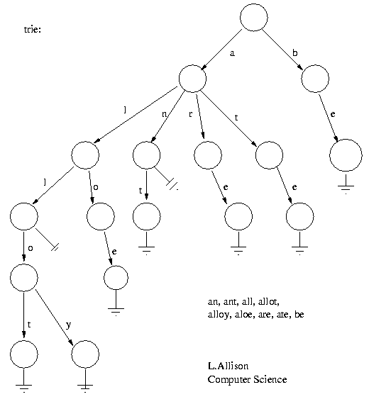
Tries, cont.
An illustration of the Trie data structure using the given data. From http://allisons.org/ll/AlgDS/Tree/Trie/
The idea: all strings sharing a common prefix hang off a common node.
A node has at most 27 children - one for each letter plus a terminator.
The elements in a string can be recovered in a scan from the root to the leaf that ends a string.
All strings in the trie can be recovered by a depth-first scan of the tree.

Slide 17
Wild-card queries

Slide 18
Wild-card queries (1 of 4)
Used in the following situations:
The user is uncertain of the spelling of a query term (e.g., Sydney vs. Sidney, -> S*dney)
The user is aware of multiple variants of spelling a term and seeks documents containing any of the variants (e.g., color v.s colour).
The user is uncertain of the correct rendition of a foreign word or phrase.

Slide 19
Wild-card queries: * (2 of 4)
A query such as al*
Known as a trailing wildcard query
The * symbol occurs only once, at the end of the search string.
find all docs containing any word beginning “al”.
A search tree on the dictionary is a convenient way of handling trailing wildcard queries.
Walk down the tree following the symbols a and l in turn, at which point we can enumerate the set W of terms in the dictionary with the prefix al.

Slide 20
Wild-card queries: * (3 of 4)
*e: find words ending in “e”: harder
Known as a leading wildcard query
Consider a reverse Trie-tree – one in which each root-to-leaf path of the Trie tree corresponds to a term in the dictionary written backwards
e.g., the term allot would be represented by the path root – t – o – l – l – a )
A walk down the reverse Trie-tree then enumerates all terms R in the vocabulary with a given suffix.

Slide 21
Wild-card queries: * (4 of 4)
How can we handle *’s in the middle of query term?
co*tion
Using a regular B-tree together with a reverse B-tree to handle wildcard queries in which there is a single * symbol

Slide 22
Answer wild-card query: co*tion
Step 1: Use the regular B-tree to enumerate the set W of dictionary terms beginning with the prefix co and a non-empty suffix
Step 2: Look up the reverse B-tree to enumerate the set R of terms ending with the suffix tion.
Step 3: Take the intersection W ∩ R of these two sets, to arrive at the set of terms
begin with the prefix co and end with the suffix tion
Step 4: Use the standard inverted index to retrieve all documents containing any terms in this intersection

Slide 23

Exercise 1
An illustration of the Trie data structure using the given data. Figure from http://allisons.org/ll/AlgDS/Tree/Trie/
Question: how can we enumerate all terms meeting the wild-card query a*e?

Slide 24
Introduction to Information Retrieval and Web Search
Evaluation

Slide 25
Evaluating search engines

Slide 26
How good are the retrieved docs?
To assess the effectiveness of an IR system (the quality of its search results), two key statistics about the system’s returned results for a query
Precision : What fraction of the returned results are relevant to user’s information need?
Recall : What fraction of the relevant documents in the collection were returned by the system?

Slide 27
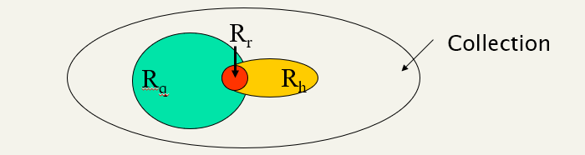
Formula (what do we have to work with?)
R_{q}= the set of docs in whole data set relevant to query, q
R_{r} = the set of docs in hit set (retrieved docs) that are relevant
R_{h}= the set of of docs in hit set
An illustration of formulas derived for Precision and Recall

Slide 28
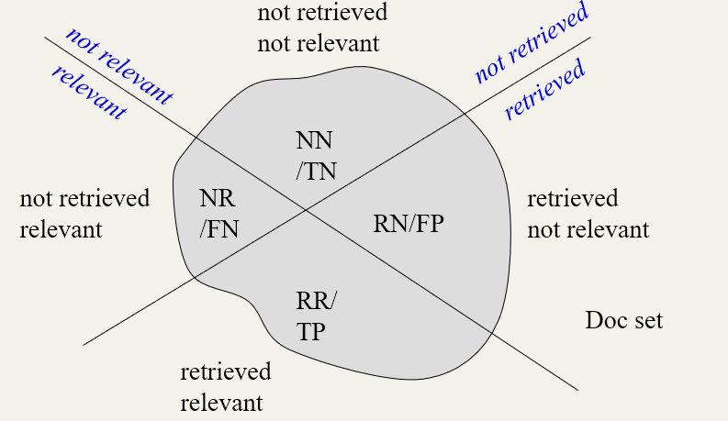
Measures based on relevance

Slide 29
Exercise 2
Problem: Assume the following:
A database contains 80 records on a particular topic
A search was conducted on that topic and 60 records were retrieved
Of the 60 records retrieved, 45 were relevant.
Calculate precision and recall scores for the search.

